Slide 1

TIME SERIES
ANALYSIS

Slide 2
TABLE OF CONTENTS
Project Statement
Project Overview
Project Requirement
Project Objectives
Technologies/Tools Used
Architecture Diagram
Execution Overview
Implementation tasks performed
Practical Implementation
Successful Output Generated
Conclusion

Slide 3
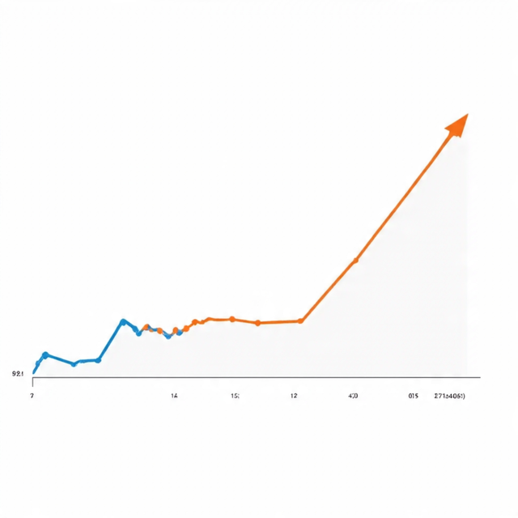
PROJECT STATEMENT
Project Statement
Goal: Perform time series analysis on website visitor data using PySparkSQL in Azure Databricks.
Focus Areas: Trend detection, seasonality analysis, and anomaly identification.

Slide 4
PROJECT OVERVIEW
This project focuses on applying Time Series Analysis techniques on a website visitor dataset. The dataset is processed, cleaned, and transformed using PySpark within Databricks. Trend analysis, seasonal pattern discovery, and anomaly detection are performed to understand visitor behavior over time. The results help in gaining actionable insights for website performance optimization.

Slide 5
PROJECT REQUIREMENT
• Dataset in CSV format
• Databricks platform for execution
• PySpark for distributed data processing
• Data stored in DBFS and processed directly in Databricks notebook using PySpark
• Visualization support for trends, seasonality, and anomaly detection

Slide 6
PROJECT OBJECTIVE
To perform time series analysis on the given dataset using Azure Databricks.
To leverage PySpark and Databricks notebooks for data preprocessing, exploration, and visualization.
To identify patterns, seasonality, and trends in the dataset for better insights.
To apply appropriate time series forecasting techniques for future value prediction.
To demonstrate the use of cloud-based analytics (Azure Databricks) for scalable and efficient time series analysis.
To evaluate the model performance and ensure accuracy of predictions.

Slide 7
TECHNOLOGIES/TOOLS USED
Databricks Notebook – execution environment
• DBFS (Databricks File System) – for storing CSV input
• PySpark (Spark SQL & Functions) – for transformations and analysis
• Databricks display() – for visualization
• Delta Tables (optional) – to save processed results if required

Slide 8
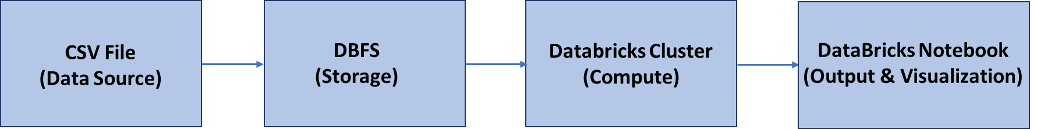
ARCHITECTURE DIAGRAM

Slide 9
EXECUTION OVERVIEW
• Upload CSV into DBFS
• Load data into PySpark DataFrame
• Perform data cleaning & formatting (date conversion, type casting)
• Apply trend analysis (daily, weekly, monthly)
• Apply seasonality analysis (day-of-week patterns)
• Perform anomaly detection using z-score method
• Visualize results using display()

Slide 10
IMPLEMENTATION TASKS PERFORMED
• Dataset Loading & Preview
• Database & Table Creation
• Data Cleaning & Column Renaming
• Date Format Standardization
• Trend Analysis (Daily, Weekly, Monthly)
• Seasonality Analysis
• Anomaly Detection using Z-Score

Slide 11
PRACTICAL IMPLEMENTATION
• Used spark.read.format("csv") for loading data
• Applied column renaming for uniformity
• Converted string dates → proper date format
• Aggregated data for trend analysis (SUM & AVG functions)
• Applied dayofweek, month, weekofyear functions
• Used Z-Score formula for anomaly detection

Slide 12
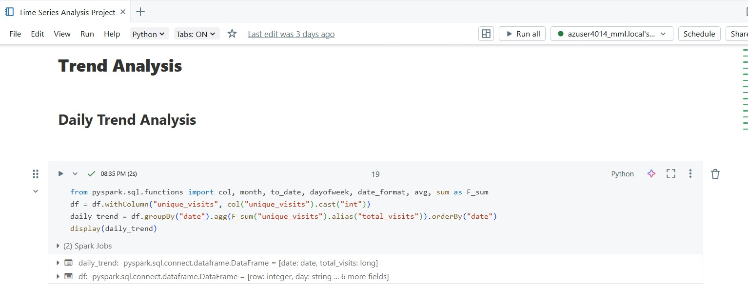
SUCCESSFUL OUTPUT GENERATED

Slide 13
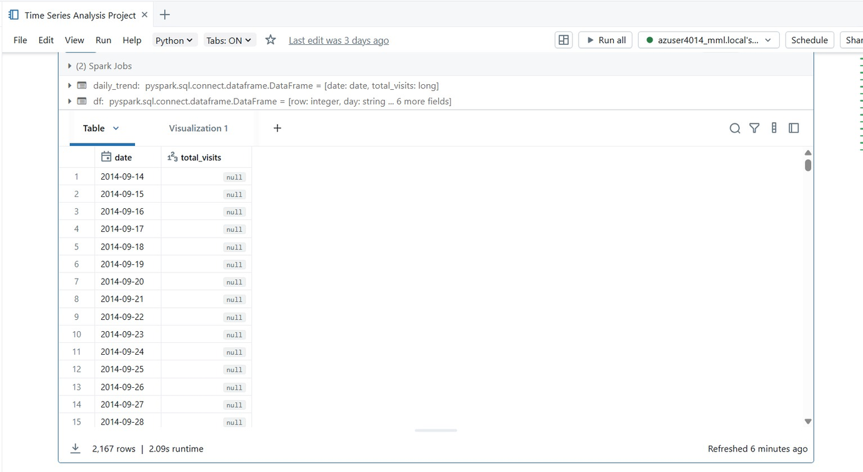
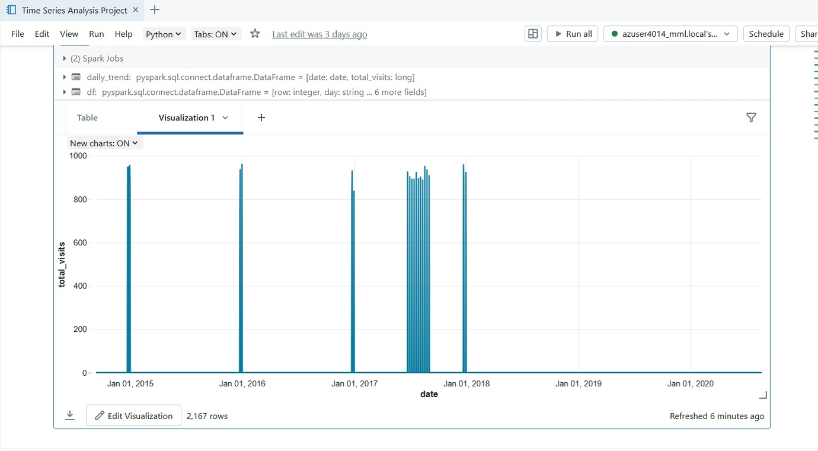

Slide 14
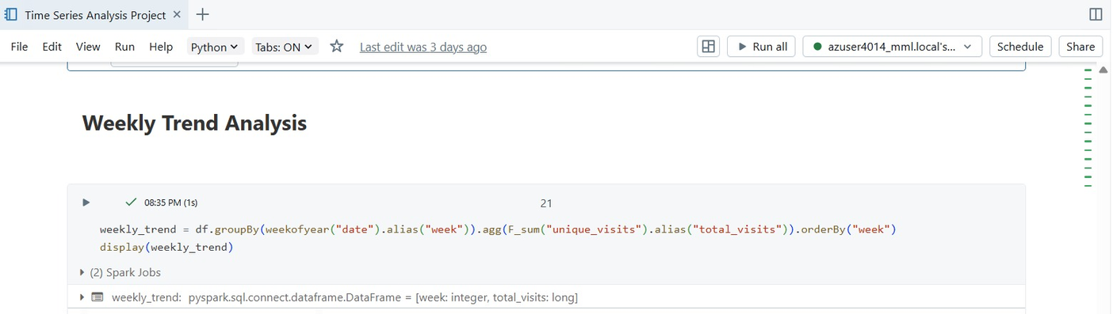
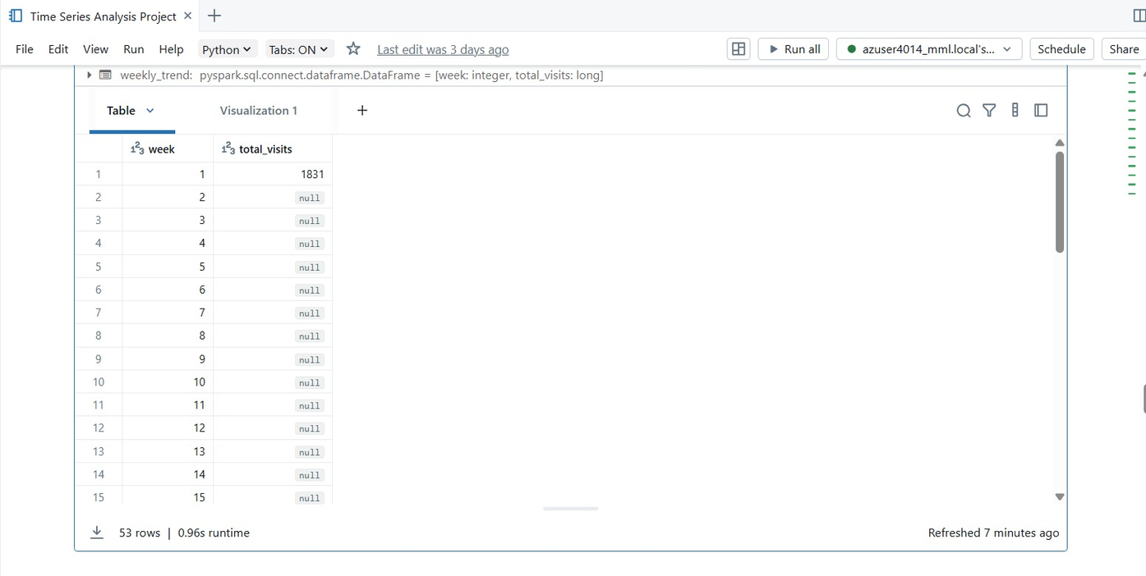

Slide 15
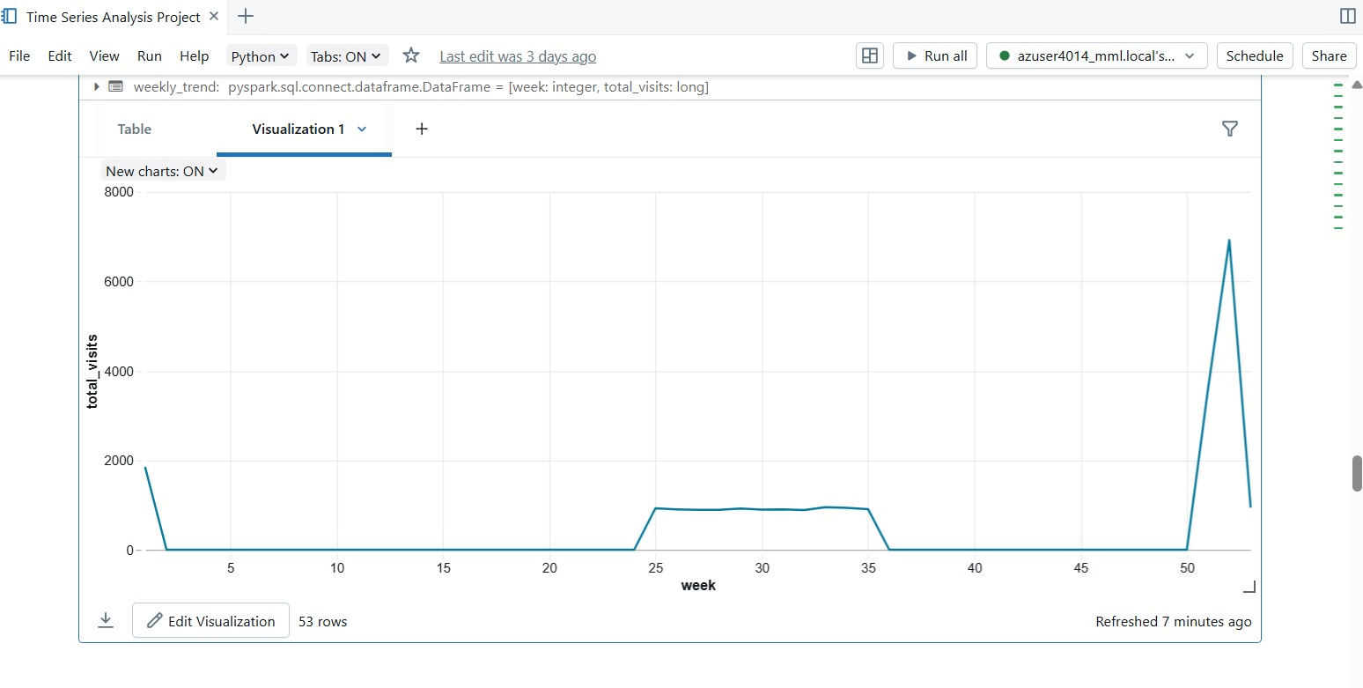

Slide 16
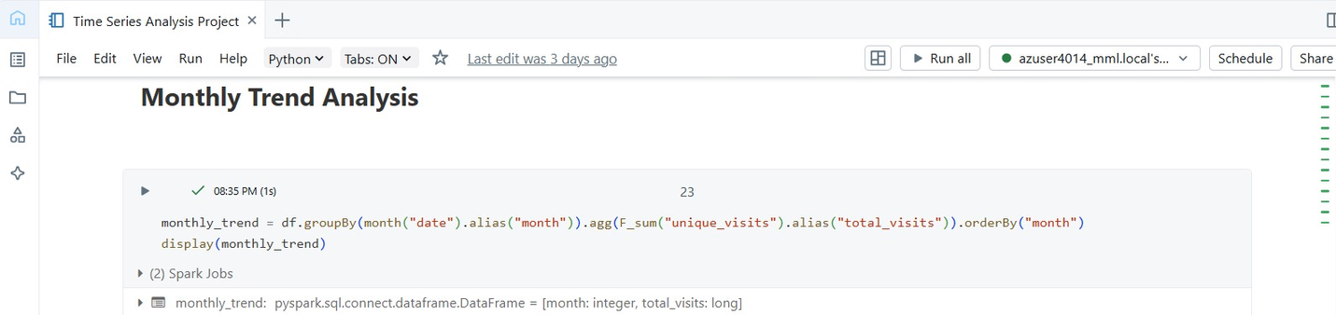
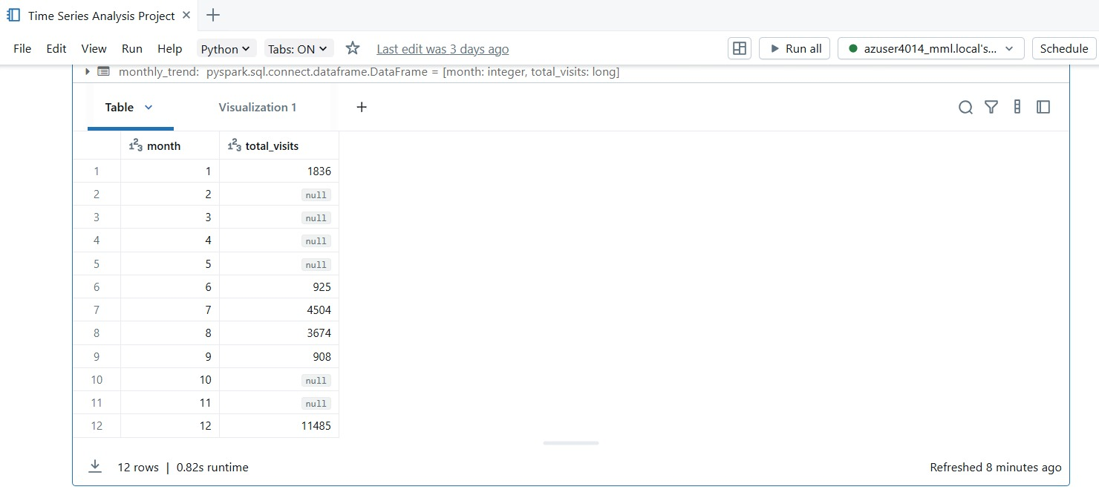

Slide 17
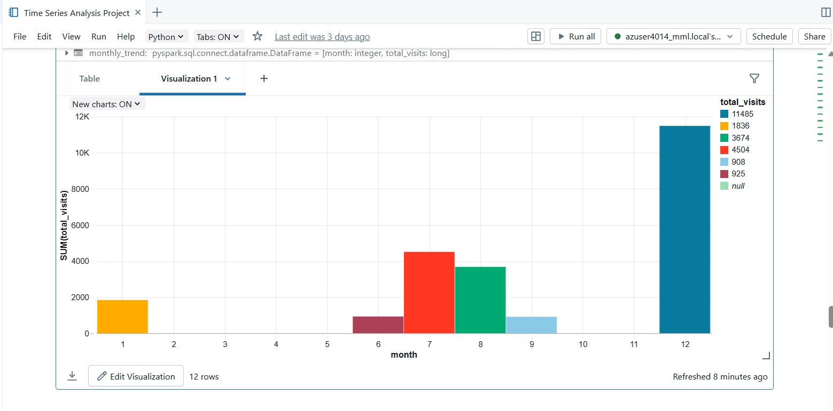

Slide 18
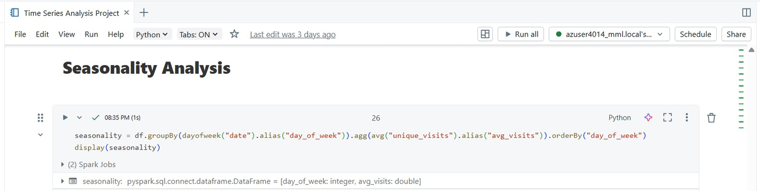
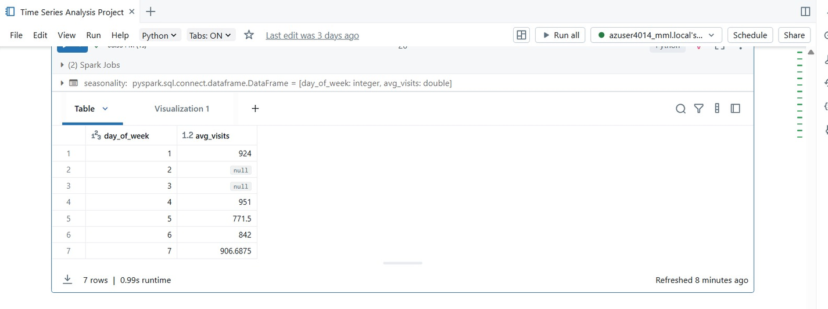

Slide 19
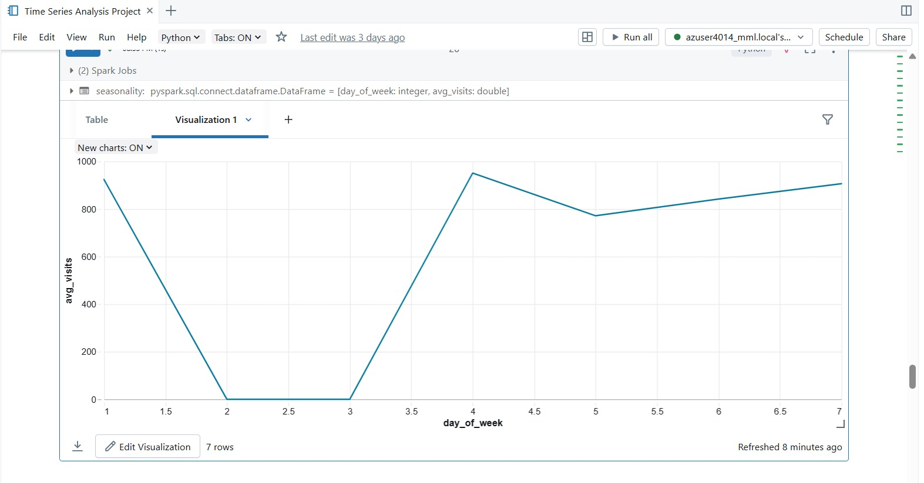

Slide 20
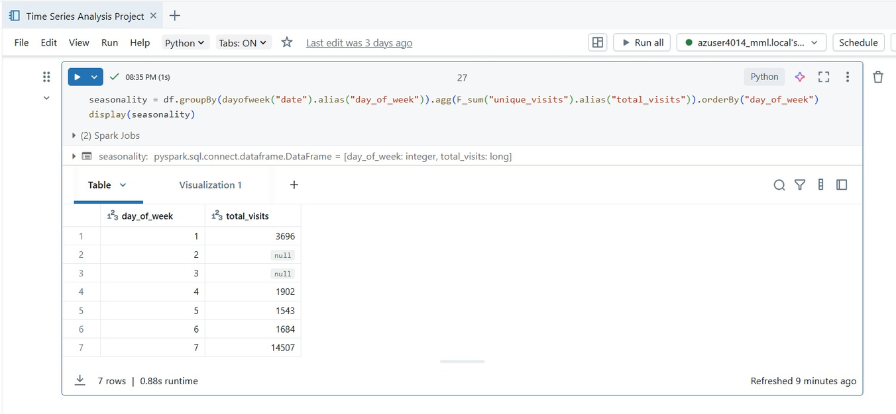
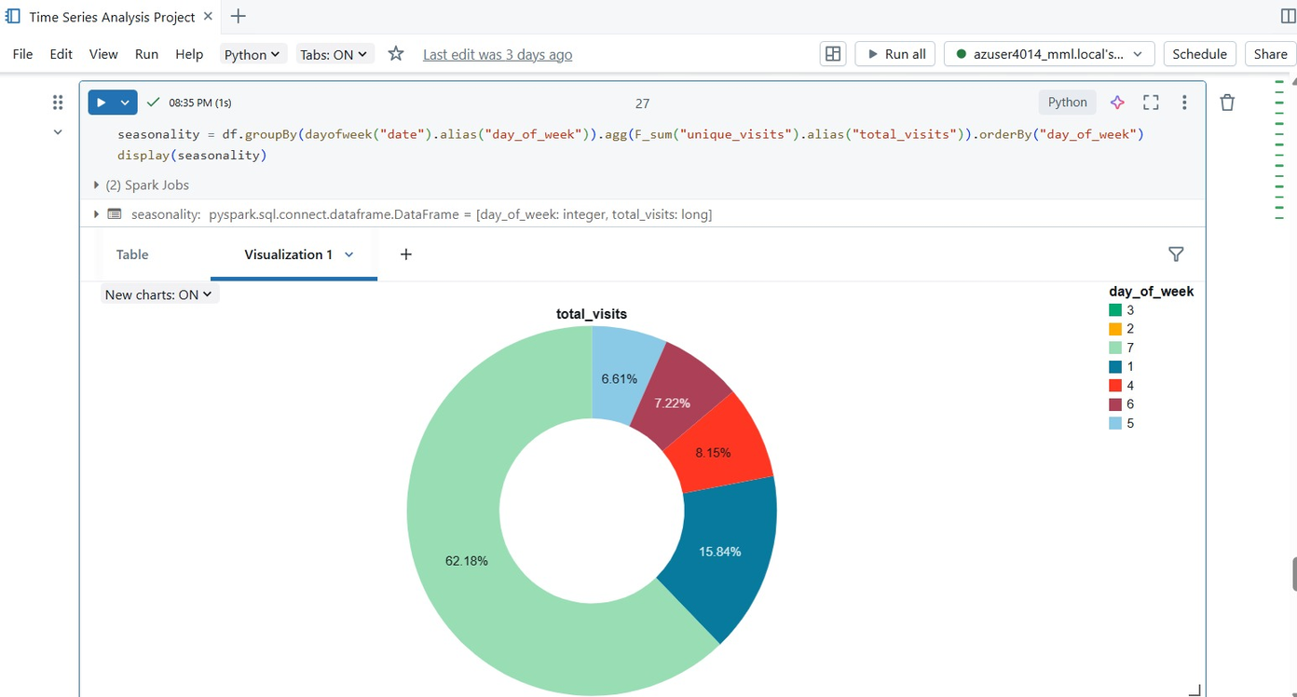

Slide 21
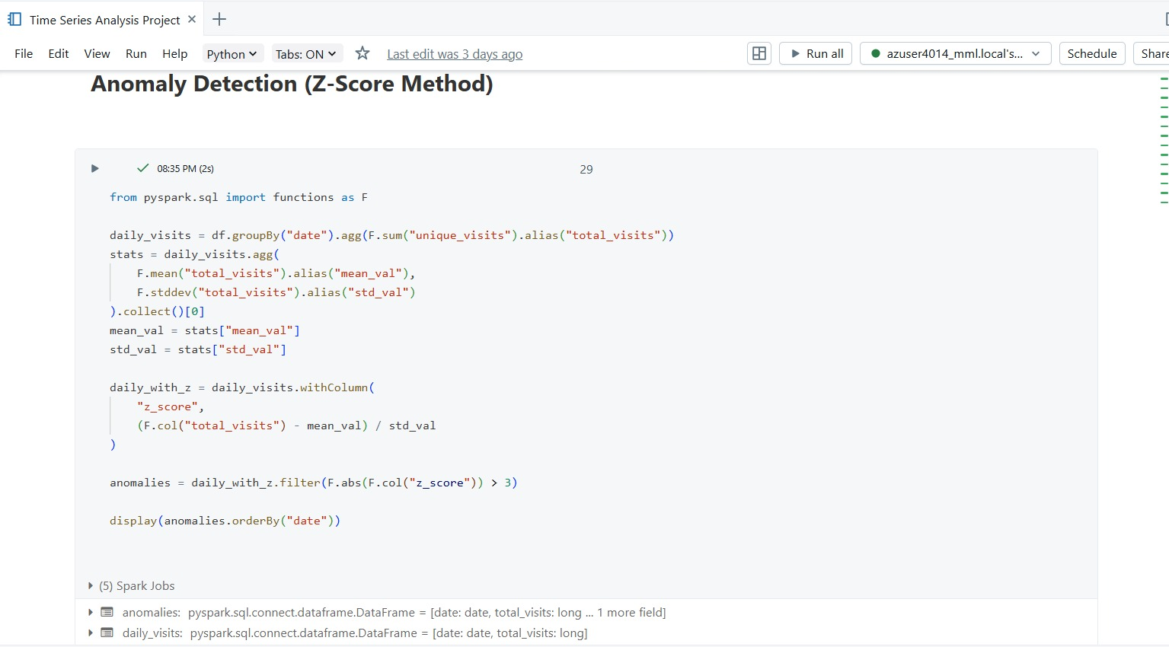

Slide 22
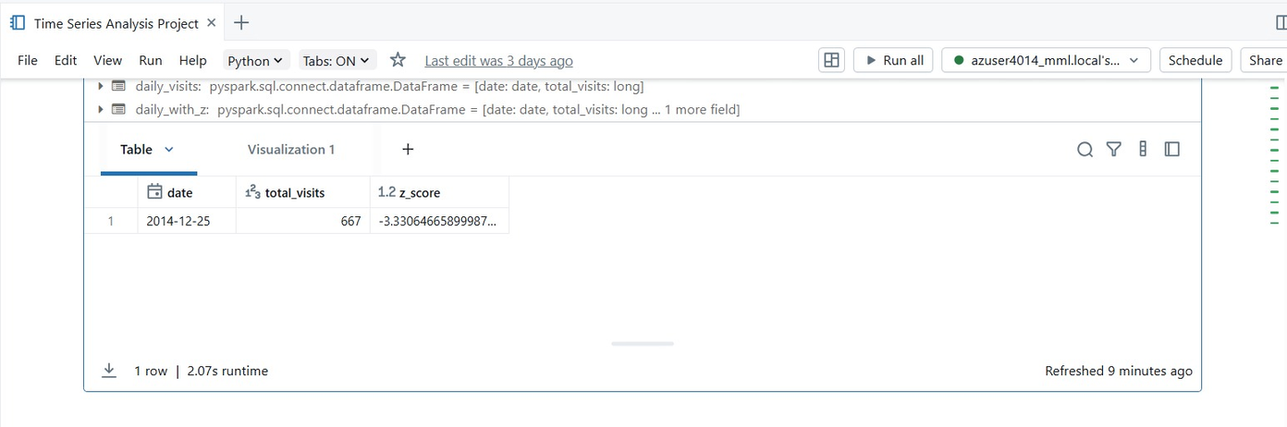
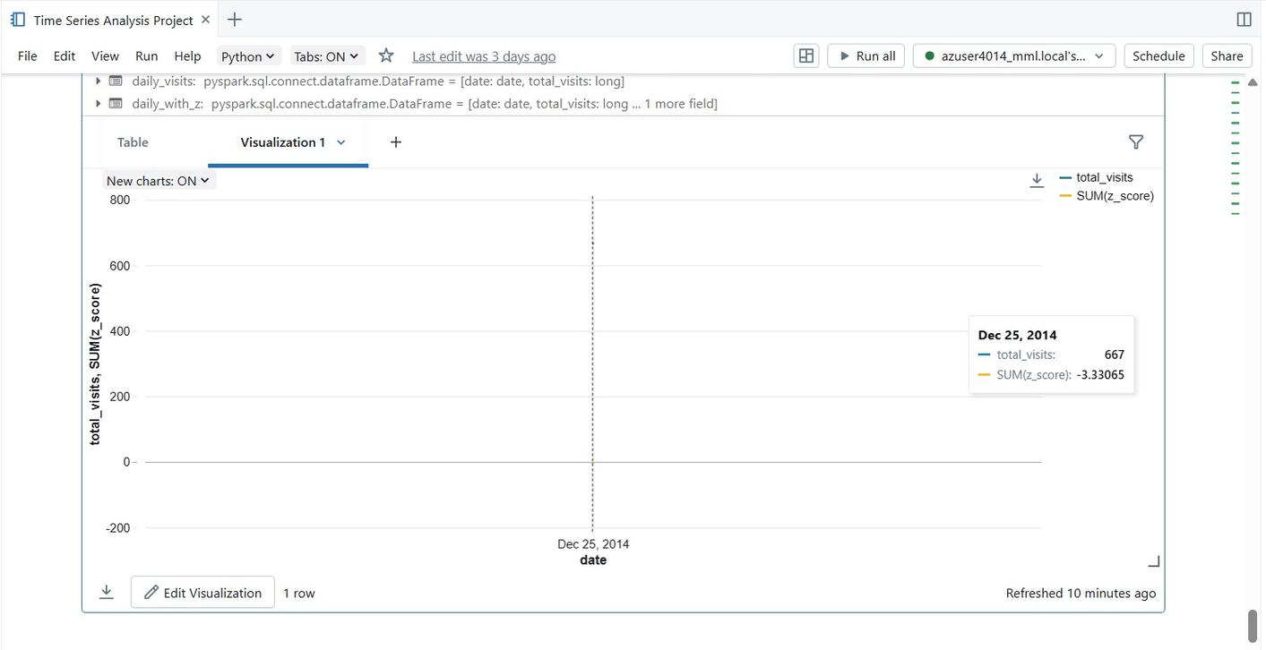

Slide 23
CONCLUSION
Project Success: Performed time series analysis on website visitor data using PySpark in Databricks.
Efficient Data Handling: Dataset uploaded and processed seamlessly within Databricks.
Time Series Exploration: Identified trends, seasonal patterns, and anomalies in visitor traffic.
Visualization & Insights: Graphs highlighted peak periods and long-term growth trends.
Optimized Environment: Interactive Databricks workspace enabled efficient transformations and collaboration.
Overall: Demonstrated scalable, cloud-based time series analysis and generated actionable insights.

